Slide 1
Technical Presentations
Keith VanderLinden
Calvin University
Notes:
See the project 4 specification for details.

Slide 2
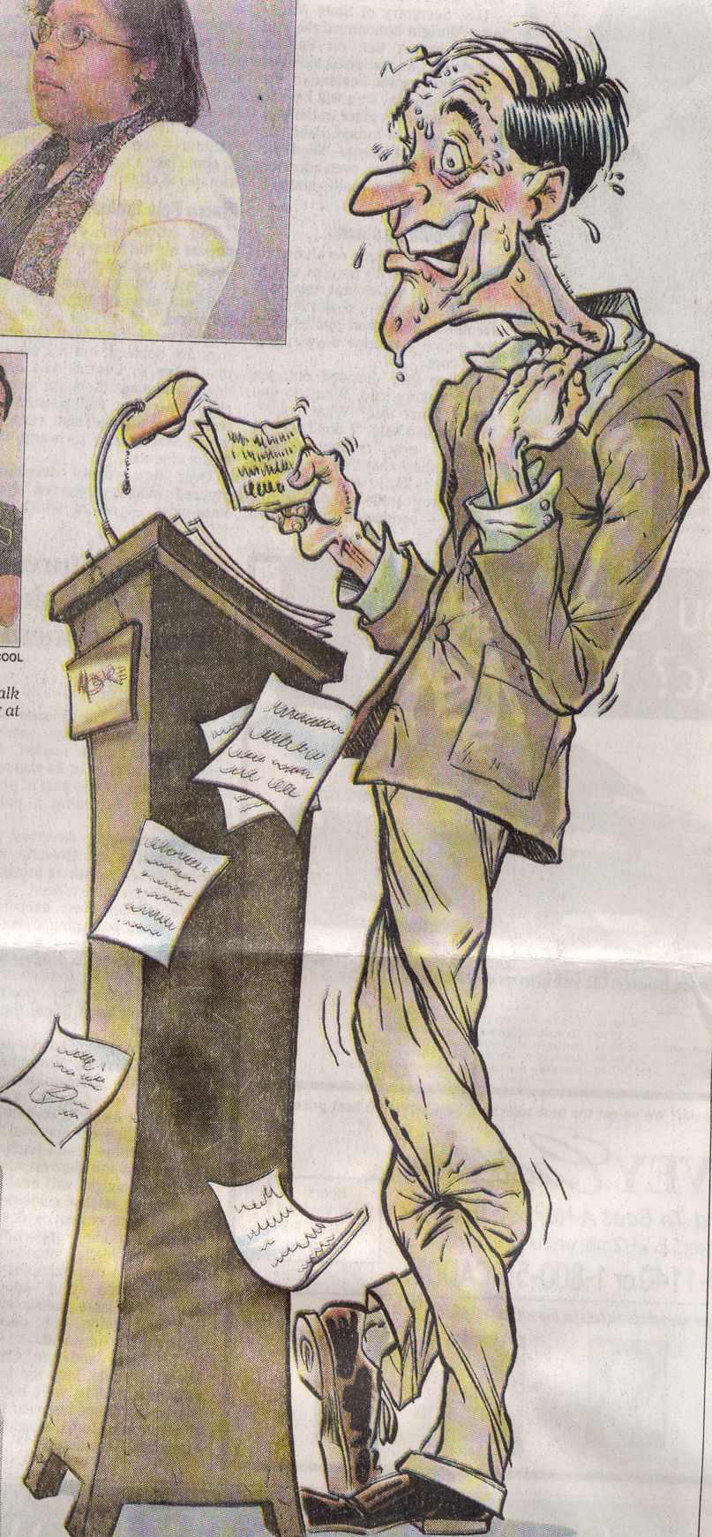
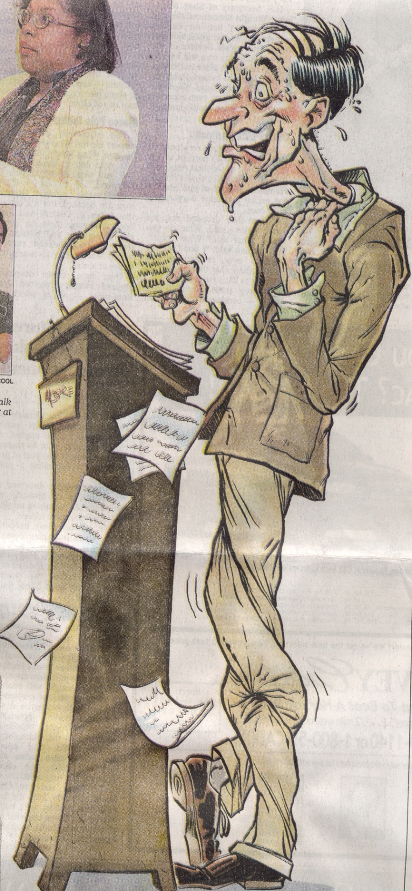
Worst Human Fears
Speaking before a group
Heights
Insects and bugs
Financial problems
Deep water
Sickness
Death
Flying
Loneliness
Dogs - Sony Corporation, 2000
GR Press
Michael Moore
March 26, 2000
Notes:
You’re going to be nervous; if you’re not, you simply don’t have a realistic grasp of the gravity of the situation.
“When I’m a bit nervous and I know what I’m talking about, I’m dynamite.” – Herb Dershem

Slide 3
Technical Presentations
Presentations are an important part of the engineering process.
Engineer them like you engineer software:
Analysis
Design
Performance
Evaluation
Notes:
Never underestimate the value of a good presentation. It may be the only thing some people see of your work. Knowing your stuff is important, but it’s not the only thing. Communication is an important “liberal” art.
Tell them the story of Nico Cavalotto’s ill-fated demo at IRST for the GIST project.
Software is not exactly like a presentation, but there are strong similarities. So, we’ll “engineer” this presentation.

Slide 4

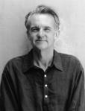
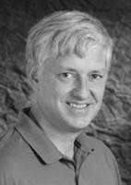
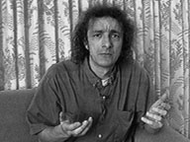
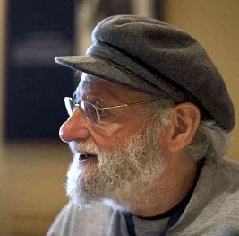
Slideware
Against
“Power Corrupts. PowerPoint Corrupts Absolutely.” – E. Tufte
“The 3rd worst invention of the 20th century” – C. Stoll
Gettysburg presentation – P. Norvig
For
“Don’t blame the tool for a poorly prepared, poorly presented talk.” – D. Norman
Images from authors’ web sites, Apr. 2004
Notes:
A host of detractors
Mostly, these guys are over-reacting. PowerPoint can be very useful if used properly (and it, or something like it, is required for your team presentations).
(See http://www.norvig.com/Gettysburg/.)
In contrast, see http://www.jnd.org/dn.mss/in_defense_of_p.html.

Slide 5
Questions
??
Save time for questions.
Moderate the question period.
!!!
Thanks
Notes:
Watch your time. I will!
Spread the questions around.
Assign the appropriate question answerer.

Slide 6
Presentation Analysis
Determine the constraints:
Audience
Venue
Time
Establish a goal.
Notes:
Determine the constraints:
Audience
Who are they? What do they know? How do you want them to respond? How formal is it intended to be?
For you, think of it as a knowledgeable computer scientist who doesn’t know your project, e.g., Vic Norman.
Venue
What equipment is there? How large is the space/audience?
For you, go scout out the room now.
Time
How much time do you have? Should there be time for questions?
Check the project 4 specification.
Establish a goal, e.g.,
“my thesis is X – believe it”
“my system solves this problem in a unique way – buy it!”
“my proposal is great – fund it”

Slide 7
Presentation Design
Base your presentation on a system demo.
Use slides for non-demo elements.
Include slide for the: title, vision, & conclusion.
Keep your slides simple.
Drive your point home.
Notes:
Use prepared slides or web pages, this will save you precious time during a formal, timed presentation.
Opening slides
Include title of talk, your name(s) and affiliation(s)
Start with your thesis (vision).
A motivating example very early helps too.
Start the demo.
Conclusion slide
Summarize the key points of your talk
Prepare three things (cf. D. Norman):
Personal notes
Illustrative slides
(handouts) A demo
Tell them what you’re going to tell them, tell them, then tell them what you told them. Presenters are not listeners; listeners are not presenters.
Figure 2-3 minutes per slide.

Slide 8
Best Practice for Slides
Don’t:
use inappropriate fonts.
put too much one each slide.
use distracting slides.
Do:
Use slides for the intro, diagrams, & images.
Focus on the demo.
Have a back-up plan in case the technology doesn’t work.
Notes:
Select an appropriate slide layout.
don’t have too many points (<6)
choose a large enough font
Technology can get in the way, so watch what you do. The “experts” are down on slideware because it can really screw things up. In CS, it’s almost required for displaying code, models, etc.

Slide 9
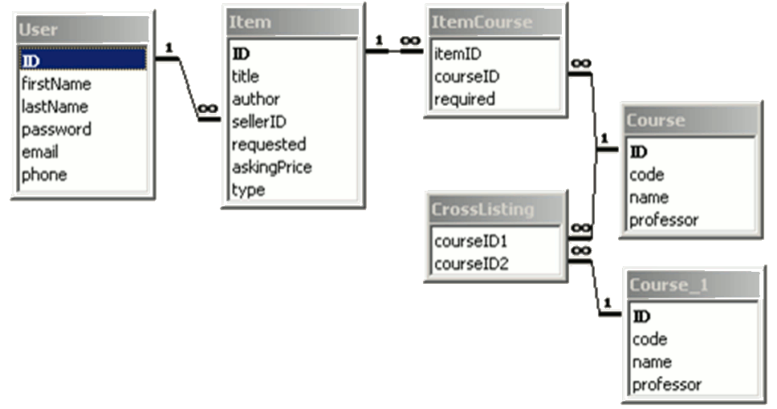
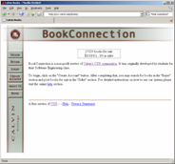
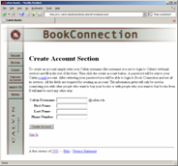
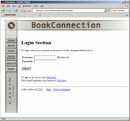
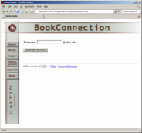
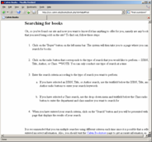
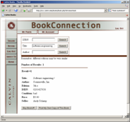

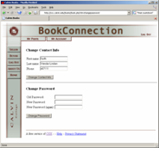

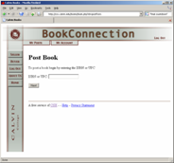
Focus on Diagrams & Images
Notes:
An image can be worth 1000 words, and PowerPoint is better at displaying them than you are, so consider displaying an image on one slide and doing the talking yourself. After all, you are better at talking than PowerPoint is. Use diagrams to design and to communicate. Don’t just do them; use them productively.
See Al Gore’s use of slideware in An Inconvenient Truth.

Slide 10
Bad Fonts
No one can see the brilliance of your points if your font is poorly chosen.
The wrong color
Or too small
Red next to green is a common problem for the colorblind.
People can’t read blue very well
Notes:
Symbol size = 0.06 * feet to last row
Audience size = 50 * (symbol size in inches)^2
Just make sure you can read the slide from the back row.

Slide 11
Too much text
Putting up a slide with too many words of plain text is dangerous. You will be sorely tempted to read it, and even if you don’t, your audience will, ignoring whatever you do no matter how crazy it is. In general, text books are for this sort of thing, not formal presentations (although there are exceptions). Better to stick to bulleted, incisive notes which you explain more fully.
Notes:
Keep your bullet points short – presentations are for general ideas, not details. And you do the talking, keep the slides as a media-oriented backup to what you are saying.
If you have to put up lengthy quotes (and think really hard about whether you REALLY need to), then read quotes out loud so everyone goes together (e.g., my dilbert comics). Don’t expect the audience to read when they should be listening to you.

Slide 12
Too many points
Some people just have too many good ideas:
Here’s one.
Here’s another.
Here’s a third.
I’m so smart, I can keep coming up with these all day.
This one is kind of like an earlier one.
This one is too, but is sort of different.
This one isn’t related at all, but I thought I’d mention it.
Now this is starting to get tiring.
No one will get this far probably.
You’ll run out of time by now.
This is for those that start reading from the bottom.
Notes:
Use 6 bullets or less.

Slide 13
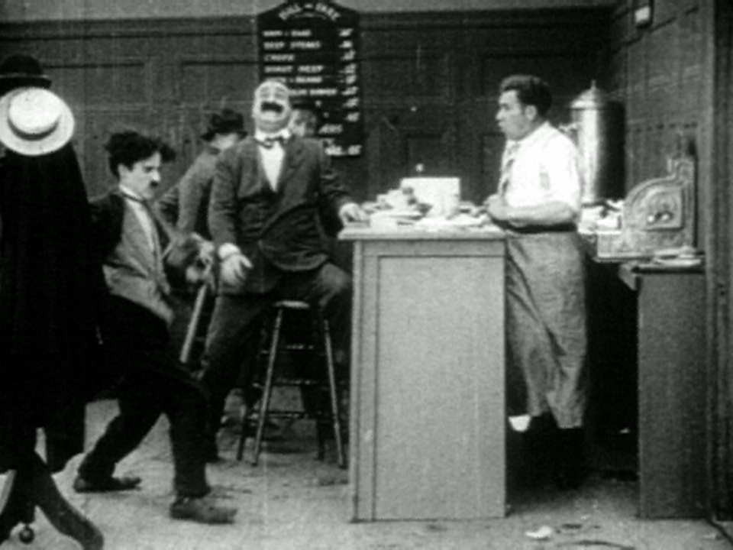
A Distracting Slide
It doesn’t matter what I say here, you won’t see it...
Notes:
You should be the most interesting thing up there.
The material on your slides should be the second most important thing.
Anything else is either a distraction or worse.

Slide 14
Silly Effects
Unrelated nonsense will detract from your fundamental purpose!
Presentation tools make these easy; resist the urge to use them.
effects by Christian Vander Linden, June, 2006
Notes:
You should be the most interesting thing up there.

Slide 15
Presentation Performance
Look “presentable”.
Establish a focus of attention:
Stand close to the slides and refer to them.
Establish and maintain eye-contact.
Work from memory, don’t read.
Keep the audience’s attention.
Presentation roles:
A team “MC” to channel attention
A separate demo operator
Notes:
“Presentable” is context dependent. Don’t over or under dress.
Standing isn’t the only way, the British academic frequently sits. Socractes lead his students around. Americans stand, so should you in most cases.
Making contact requires eye-contact (no reading) and using gestures to “bring them in”. Memorization sounds forced, but do learn to work extemporaneously from an outline.
Use cards to get you going if you really need them. I frequently write out the first sentence on the first slide in case I freeze up at the beginning; that’s usually enough to get me going and the rest comes with simple reminders from the slides. Philosophers frequently read their presentations, otherwise reading is a bad idea - it exudes a lack of interest and is quite boring. One might just as well read the paper.
Keep their attention through whatever appropriate means possible (e.g., stories, pictures, nonsense)
Other general ideas:
Nervousness – it’s inevitable. When I’m nervous and I know what I’m talking about, I’m dynamite!
Review each slide, then discuss it
Don’t get side-tracked

Slide 16
Demos
Technical presentations often have demos.
Engineer the demo as the driving element of the presentation.
Notes:
I often treat my talks as annotated demos. E.g., My Welcome-to-Calvin talk based entirely on cs.calvin.edu webpages. You could consider this for your final presentation.
Include a “demo” slide with key goals listed, and perhaps some hidden screen dump pages in case the demo doesn’t work.
This presentation doesn’t include a system demo; yours will!

Slide 17
Practice, Practice, Practice!
Practice in the real room with real people.
Practice the interaction between the speaker and the demo operator.
Practice taking questions at the end.
Notes:
Time your practice sessions closely.
Mark Twain said it usually took him 2 or 3 weeks to work up a good impromptu speech.

Slide 18
Evaluation
Let your preliminary design presentation be your first iteration.
Take stock of the comments you receive when preparing your final presentation.
Notes:
Comments:
My comments
Other student comments
Questions during the presentation
Your own reflections on how things went
I generally see a marked improvement from one to the next.

